Slide 1



Customer Regularity Prediction
Hard Churn v.s. Rock Star
Team:
Kelly Zhao, Ray Liu, David Chen,
De Lu, Lily Chou
Dec 9th, 2019

Slide 2
Objectives
Q1.
How accurately can we predict next-period hard churn? (report AUC on test set) What variables are power predictors? Which models do best?
Q2.
How accurately can we predict next-period rock starness? (report AUC on test set) What variables are power predictors? Which models do best?
Q3.
How accurately can we predict next-period log-regularity? (report R2 on test set) What variables are power predictors? Which models do best?
Q4.
Do we need two binary classification models, or just one regression model? Justify your answer
Q5.
What NN architecture and training to you suggest? How many hidden notes? By-pass connectors? Regularization?
Given monthly record of each user
(1) Predict next period Churn
(2) Predict next period Rock Star
(3) Predict next period Regularity
use reading behaviors this month to predict churn/star status next month
Compare R2/AUC to find the best model & powerful predictors
SFC can take actions before they Churn!

Slide 3



01
02
03
Data Cleaning
& Feature Selection
Modeling
Summary
Agenda
(1) Predict next period Churn
(2) Predict next period Rock Star
(3) Predict next period Regularity

Slide 4
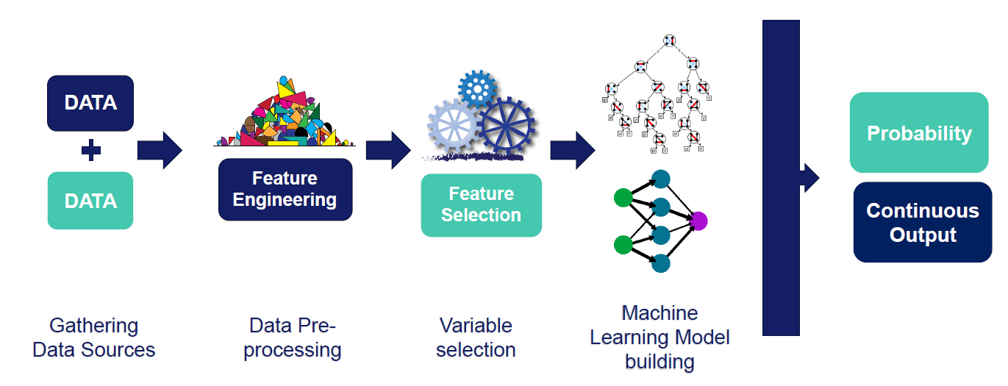
Data Modeling Pipeline
Handle missing data
Variable Encoding
Transformation Distribution Scaling
PCA
Lasso
Random Forest
Gathering Data Source/ Preprocessing

Slide 5

01
Data Cleaning
& Feature Selection

Slide 6
Gathering Data Source/ Preprocessing
Create / remove variables
Join the 2 tables
- Create variables from last month (1-2%improvement): readingDayNum_last_month + if it is NA
- Remove: ID, end date, etc.
- Inner Join the 2 tables: modeldataNoCensor.txt and idtrain.csv
Create predictive variables
Categorize data/Variables
- for each ID, shift readingDayNum/churn by 1 month and remove the missing columns, we get:
- readingDayNum_next_month - churn_next_month
- Train- Test Split
- 9 discrete variables
- 108 continuous variables
- 11 categorical variables

Slide 7
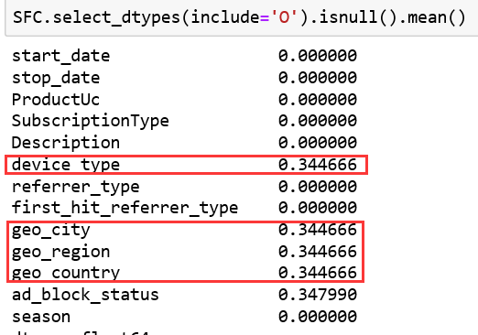
Feature Engineering
Handle Missing data
Check missing value
Only categorical data have missing value
Fill the missing data with NA

Slide 8
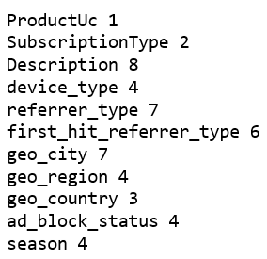
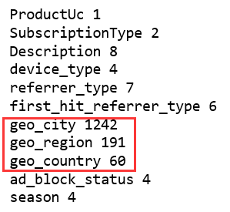
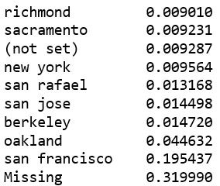
Feature Engineering
Encode Categorical variable (Rare-one-hot-encoding)
Geo related variables have too many rare categories
Label rare(<1%) categories as ‘rare’
Get dummies, 50 binary variables in total

Slide 9
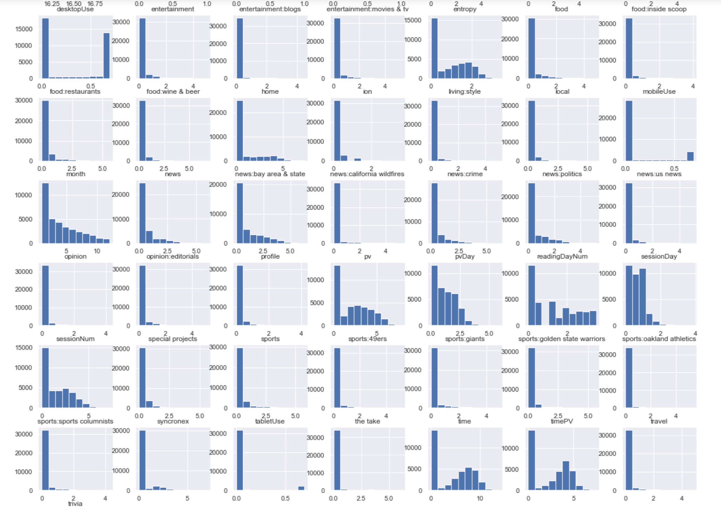
Feature Engineering
Distribution Transformation:
Some Numerical Variables are extremely right-skewed
Compared log(1+x) transformation and Box-Cox transformation (1/x)
log(1+x) is slightly better for linear models

Slide 10
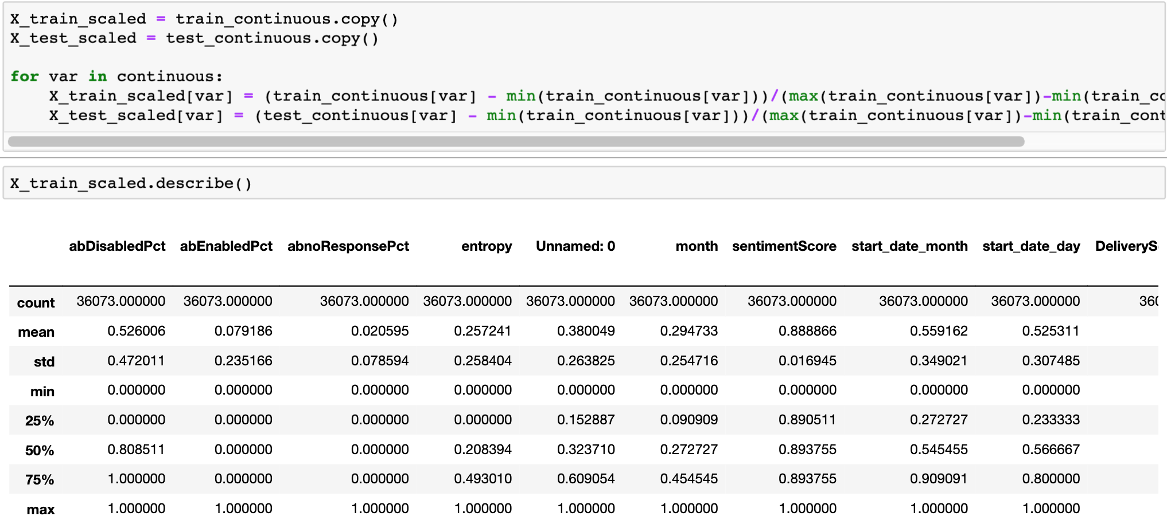
Feature Engineering
Scale the range of variables to (0-1)

Slide 11
Feature Selection
Variables from raw data (Messy)
Linear regression with lasso/
logistic regression with lasso
100+ variables
160 variables
10-20 variables
Lasso/RF/LGBM
Important features
10-20 variables
Neural networks
Best predictors

Slide 12

02
Modeling

Slide 13
Predict next period Regularity
Variable: readingDayNum_next_month
Linear Regression
Use only 2 variables
( readingDayNum and time)
R squared:
-9.66e+24
Coefficient of determination:
0.67
Over Fitting!!

Slide 14

(1) Predict next period Regularity
Variable: readingDayNum_next_month
Model Summary
Predict next period Regularity | PCA 0.95 | Only 2 variables (linear regression) | Lasso (linear regression) | LGB selection+ NN | Lasso features + NN | Lasso + RF | PCA + NN | RF
R-Square | 0.63 | 0.66 | 0.64 | 0.732 | 0.72 | 0.71 | 0.44 | 0.51

Slide 15
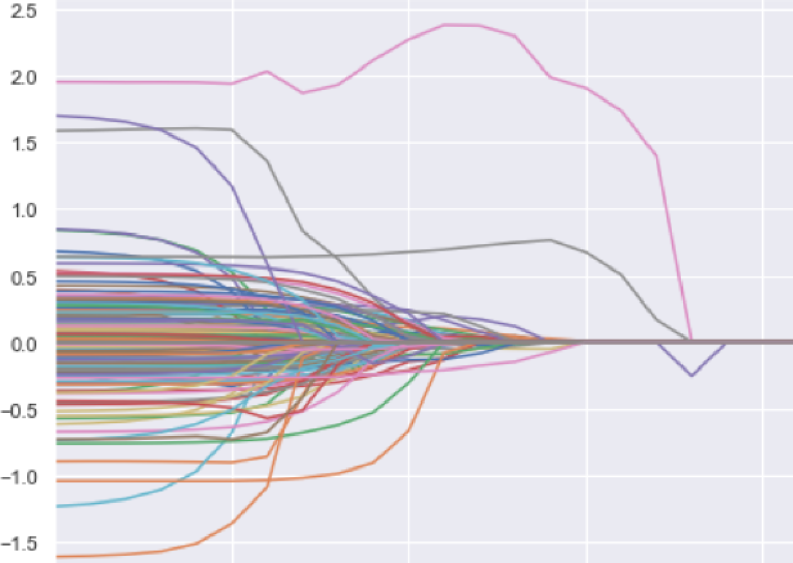
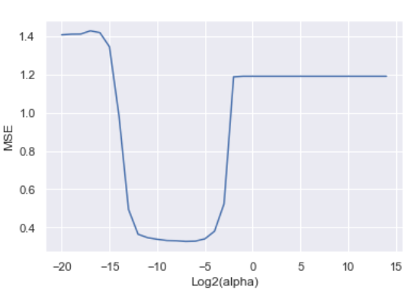
Lasso regression path for readingDayNum_next_month
Lasso path
Penalty vs MSE

Slide 16
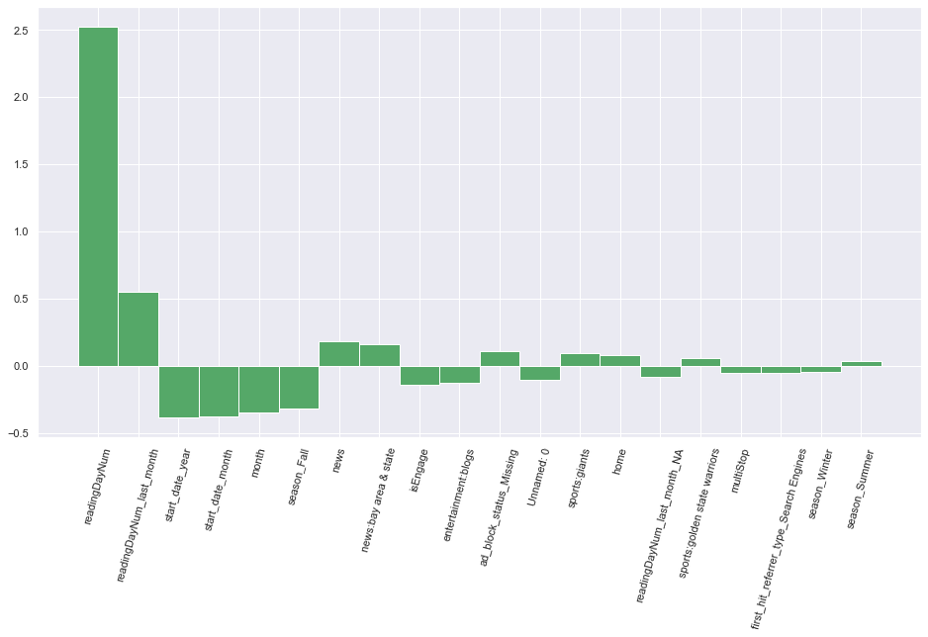
Lasso
Important variables
readingDayNum
readingDayNum_last_month
Start_day
Month
season...

Slide 17
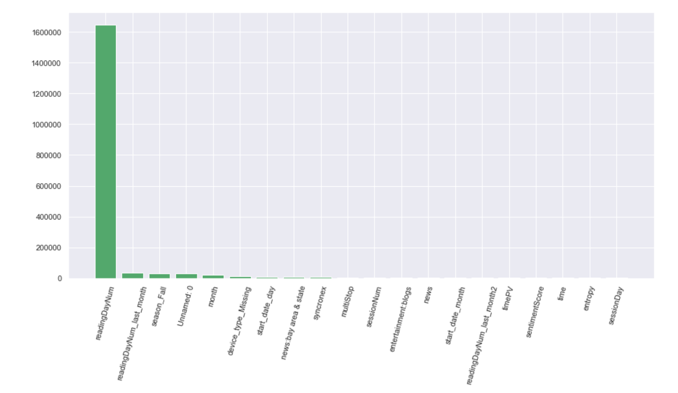
LightGBM
Important variables

Slide 18
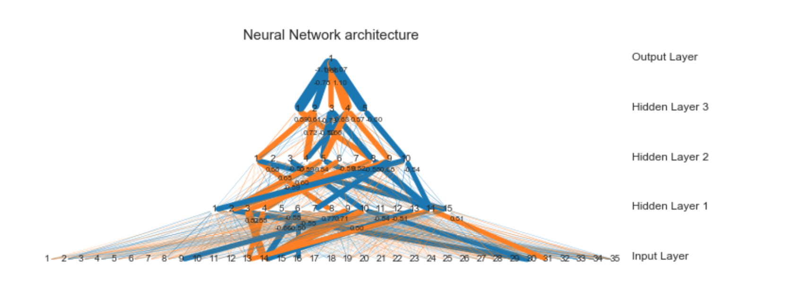
Neural Network Architecture
Notes:
https://www.asimovinstitute.org/neural-network-zoo/

Slide 19
(2) Predict next period Churn
Variable: churn_next_month
Model Summary
Predict next period Churn | Logistic Regression | Lasso + Logistic Regression | Lasso + NN | Lasso + RF
AUC | 0.663 | 0.798 | 0.673 | 0.623

Slide 20
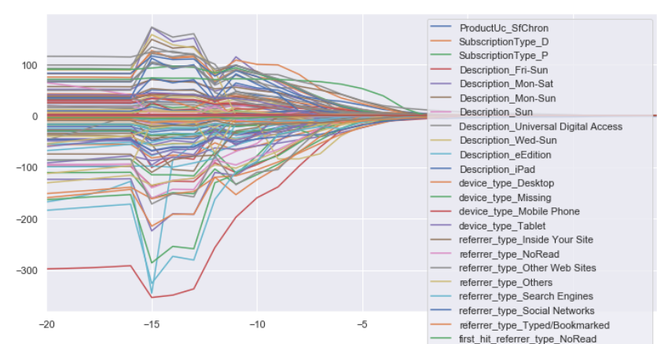
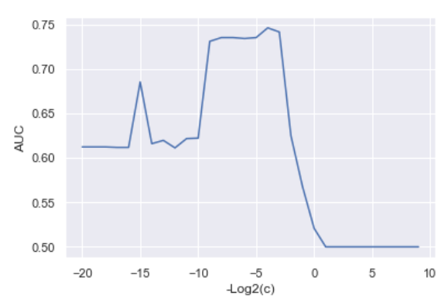
Lasso regression path for churn_next_month
Penalty vs AUC
Lasso Path

Slide 21
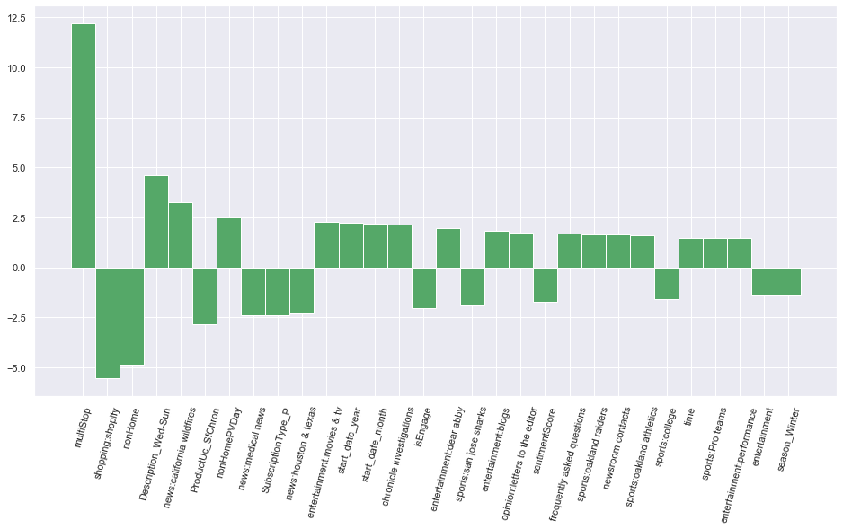
Lasso
Important variables
Predict Churn

Slide 22
(2) Predict next period Soft Churn
Variable: churn_next_month
Model Summary
Predict next period Churn | Logistic Regression | Lasso +RF | Lasso + NN | Lasso + Logistic Regression
AUC | 0.807 | 0.841 | 0.841 | 0.805

Slide 23
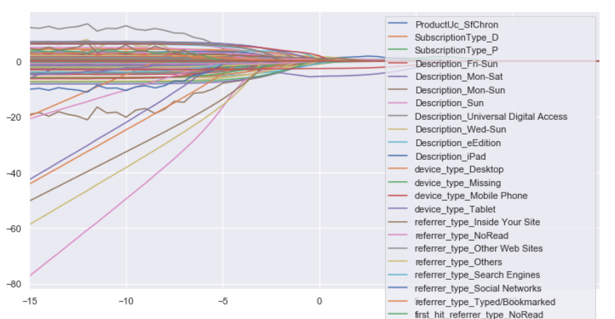
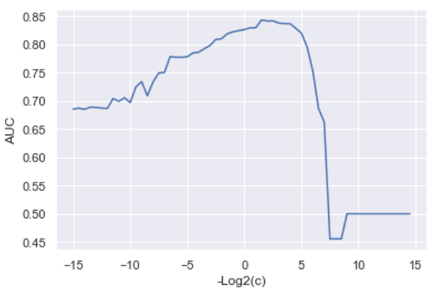
Lasso regression path for churn_next_month
Penalty vs AUC
Lasso Path

Slide 24
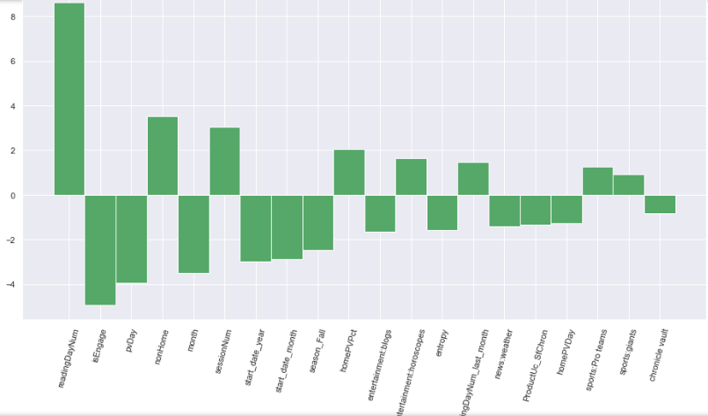
Lasso
Important variables
Predict
Soft Churn

Slide 25
(3) Predict next period Rock Star
Variable: rock_star_next_month
Model Summary
Predict next period Churn | Logistic Regression | Lasso + Logistic Regression | Lasso + RF | Lasso + NN | PCA + NN
AUC | 0.724 | 0.713 | 0.812 | 0.847 | 0.741

Slide 26
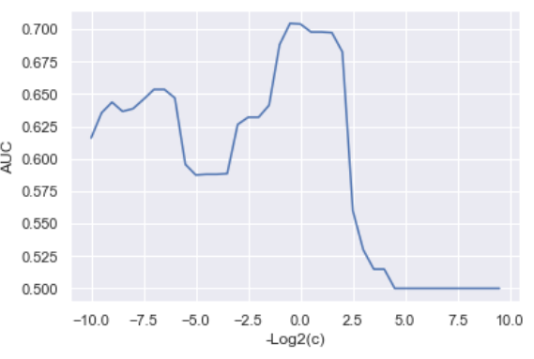
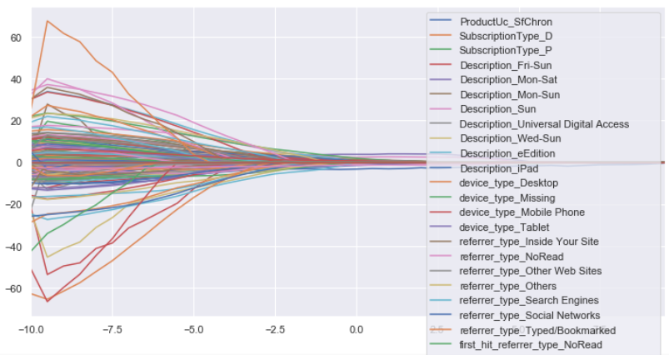
Lasso path for rock_star_next_month
Penalty vs MSE
Lasso Path

Slide 27
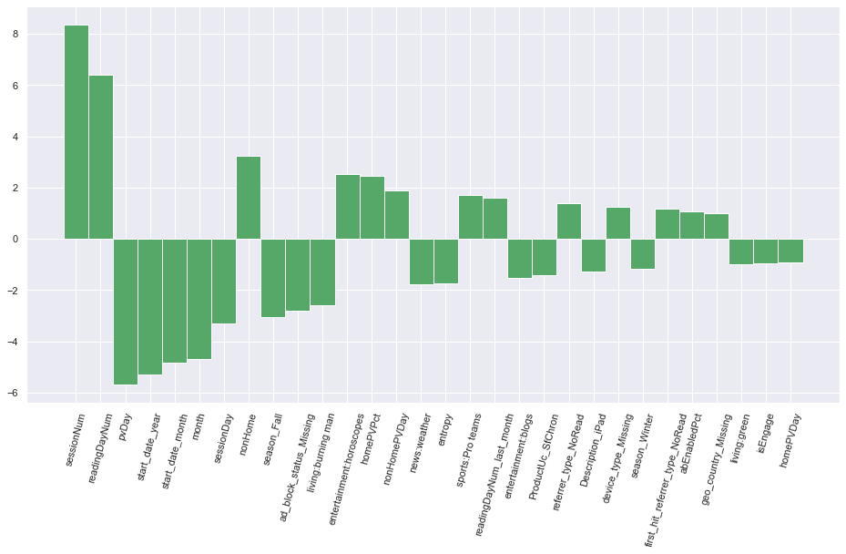
Lasso
Important variables
Predict Rock Star

Slide 28

03
Summary

Slide 29
Summary
Which model is the best
Predict next period Regularity | LGB for features selection + NN R_Square: 0.732
Predict Churn (binary classification) | Lasso for features selection + Logistic Regression AUC: 0.798
Predict Churn (binary classification) | Lasso for features selection + NN/RF AUC: 0.841
Predict Rock Star (binary classification) | Lasso for features selection + NN AUC: 0.847
The prediction is 1-2% better when we use past 2 month data versus only 1 month data
Notes:
AUC sorting ppl from best to worst

Slide 30
Powerful predictors ?
Predict next period Regularity
(Log Reading day next month)
Predict Churn
(binary classification)
readingDayNum
readingDayNum_last_month
Start_day
Month
season...
Multi-stop
Shopping
Non-home
Wed- Sun
Wirefile
Predict Soft Churn
(binary classification)
Predict Rock Star
(binary classification)
readingDayNum
isEngage
Pv/Day
Non-home
Month
Session number
Reading day number
pv/Day
Start day year
Start day month
Notes:
set THRESHOLD for Precision & Recall
WE CAN RANK THE CUSTOMER (AUC sorting ppl from best to worst)

Slide 31
Next Step:
After we identify soft churn/hard churn, we can prevent users from churnning by:
Further segmentation and customize contents : bay area local news, medical, entertainment topics etc
Deliver through a personalized way : personalized newsletter
Model selection: 2 classification models VS 1 regression model ?
2 classification models:
different important features for rock Star and soft churn
easier to explain to business people, and more actionable
clear objective (Precision and Recall on ROC Curve)
1 regression model:
Can have continuous indicators
Can rank among customers.
Less model

Slide 32
THANKS
What questions can we answer ?

